Slide 1

Introduction about the Course
BCSE202L Data Structures and Algorithms
Session #1
Dr. T. JOSHVA DEVADAS
Associate Professor Senior
Department of Analytics
School of Computer Science and Engineering (SCOPE)
Vellore Institute of Technology (VIT)
Vellore
joshvadevadas.t@vit.ac.in

Slide 2
Contact Information
Office Cabin: SJT Annex (WTP) 103 F
Email: joshvadevadas.t@vit.ac.in
Mobile Number: 97895 60120
Open Hours:
Monday: 10:00 am to 11:00 am
Wednesday: 11:00 am to 12:00 Noon

Slide 3
BCSE202L Data Structures and Algorithms
L T P J C
3 0 0 0 3
Programming forms the core of Computer Science and Engineering . A course on “Data structures and Algorithms‟ stresses much on effective programming than focusing on the syntax / semantics of any programming language. In other words, this course views the problem solving not just as solving the problem somehow but about solving the problem in the most efficient way. Choice of an appropriate data structure and an appropriate algorithmic technique greatly influences the characteristics of the obtained solution such as performance, space requirements , scalability, reuse, robustness etc.

Slide 4
Objective
1. To impart basic concepts of data structures and algorithms.
2. To differentiate linear, non-linear data structures and their operations.
3. To comprehend the necessity of time complexity in algorithms..

Slide 5
:
Expected Course Outcome
On completion of this course, students should be able to:
1. Understand the fundamental analysis and time complexity for a given problem.
2. Articulate linear, non-linear data structures and legal operations permitted on them.
3. Identify and apply suitable algorithms for searching and sorting.
4. Discover various tree and graph traversals.
5. Explicate hashing, heaps and AVL trees and realize their applications.

Slide 6
Data Structures
Primitive DS
Non-Primitive DS
Int
float
Linear( Sequential)
Non Linear
(Random)
char
Double
Pointer
Arrays
List
Stack
Queue
Trees
Graph
Single LL
Double LL
Circular LL
Binary Tree
Binary Search Tree

Slide 7
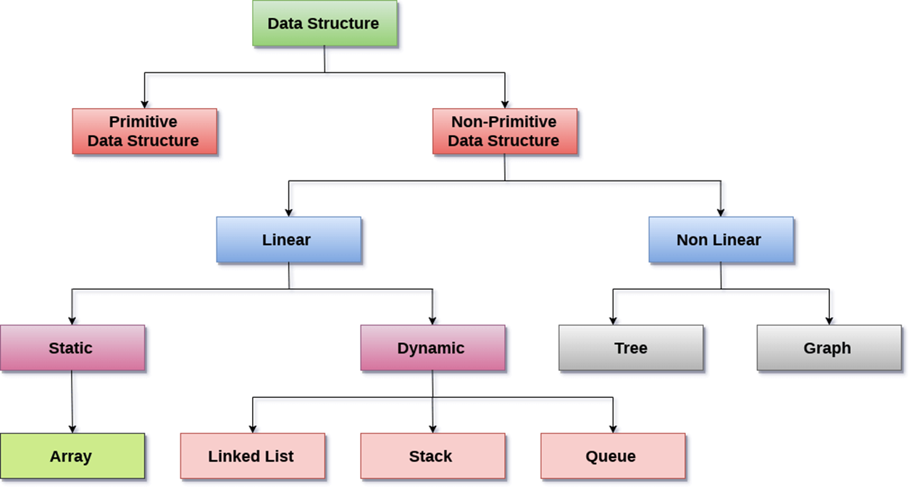

Slide 8
Operations
Sorting
Searching
Insertion
Deletion
Updating

Slide 9
Modules
Algorithms and Analysis 8 hours
Importance of algorithms and data structures - Fundamentals of algorithm analysis: Space and time complexity of an algorithm, Types of asymptotic notations and orders of growth - Algorithm efficiency – best case, worst case, average case - Analysis of non-recursive and recursive algorithms - Asymptotic analysis for recurrence relation: Iteration Method, Substitution Method, Master Method and Recursive Tree Method.

Slide 10
Linear Data Structures 7 hours
Arrays: 1D and 2D array- Stack - Applications of stack: Expression Evaluation, Conversion of Infix to postfix and prefix expression, Tower of Hanoi – Queue - Types of Queue: Circular Queue, Double Ended Queue (deQueue) - Applications – List: Singly linked lists, Doubly linked lists, Circular linked lists- Applications: Polynomial Manipulation.
Searching and Sorting 7 hours
Searching:
Linear Search and binary search – Applications.
Sorting: Insertion sort, Selection sort, Bubble sort, Counting sort, Quick sort, Merge sort - Analysis of sorting algorithms.

Slide 11
Non-linear Data Structures - Trees 6 hours
Introduction - Binary Tree: Definition and Properties - Tree Traversals- Expression Trees:- Binary Search Trees - Operations in BST: insertion, deletion, finding min and max, finding the kth minimum element.
Non-linear Data Structures - Graphs 6 hours
Terminology – Representation of Graph – Graph Traversal: Breadth First Search (BFS), Depth First Search (DFS) - Minimum Spanning Tree: Prim's, Kruskal's - Single Source Shortest Path: Dijkstra’s Algorithm.
Hashing 6 hours
Hash functions - Separate chaining - Open hashing: Linear probing, Quadratic probing, Double hashing - Closed hashing - Random probing – Rehashing - Extendible hashing.

Slide 12
Heaps and Balanced Binary Search Trees (AVL Trees) 5 hours
Heaps - Heap sort- Applications -Priority Queue using Heaps. AVL trees: Terminology, basic operations (rotation, insertion and deletion).
Contemporary Issues 2 hours
  Recent trends in algorithms and data structures
TextBook
  Mark A. Weiss,Data Structures & Algorithm Analysis in C++, 4th edition, 2013, PEARSON education

Slide 13
Reference Books
1. Alfred V. Aho, Jeffrey D. Ullman and John E. Hopcroft, Data Structures and Algorithms, 1983, Pearson Education.
2. Horowitz, Sahni, and S. Anderson-Freed , Fundamentals of Data Structures in C UNIVERSITIES PRESS,Second Edition,2008.
3. Thomas H. Cormen, C.E. Leiserson, R L. Rivest and C. Stein, Introduction to Algorithms, 2009, 3rd Edition, MIT Press.

Slide 14
BCSE202P Data Structures and Algorithms
L T P J C
0 0 2 0 1
Programming forms the core of Computer Science and Engineering . A course on “Data structures and Algorithms‟ stresses much on effective programming than focusing on the syntax / semantics of any programming language. In other words, this course views the problem solving not just as solving the problem somehow but about solving the problem in the most efficient way. Choice of an appropriate data structure and an appropriate algorithmic technique greatly influences the characteristics of the obtained solution such as performance, space requirements , scalability, reuse, robustness etc.

Slide 15
Course Objectives
1. To impart basic concepts of data structures and algorithms.
2. To differentiate linear, non-linear data structures and their operations.
3. To comprehend the necessity of time complexity in algorithms.
Course Outcomes
On completion of this course, students should be able to:
1. Apply appropriate data structures to find solutions to practical problems.
2. Identify suitable algorithms for solving the given problems.

Slide 16
Indicative Experiments
1. Implementation of stack data structure and its applications
2. Implementation of queue data structure and its applications
3. Implementation linked list and its application
4. Implementation of searching algorithms
5. Implementation of sorting algorithms
6. Binary Tree Traversal implementation
7. Binary Search Tree implementation
8. Graph Traversal – Depth First Search and Breadth First Search algorithm
9. Minimum Spanning Tree – Prim’s and Kruskal’s algorithm
10. Single Source Shortest Path Algorithm - Dijkstra’s algorithm

Slide 17
Assessment Methods
CAT1
CAT2
QUIZ 1 (Moodle) [NEXT Week after CAT1 EXAM]
QUIZ 2 (Moodle) [NEXT Week after CAT2 EXAM]
Digital Assignment 1(Moodle)
Final Assessment Test (FAT)

Slide 18
Contact Information
Office Cabin: SJT ANNEX (WTP) 103 F
Email: joshvadevadas.t@vit.ac.in
Mobile Number: 97895 60120
Open Hours:
Monday: 10:00AM to 11:00 AM
Wednesday: 11:00AM to 12:00Noon

